Slide 1
Biology 101: Communities
SECTION 2
DR. ANAND
APRIL 26 2017

Slide 2
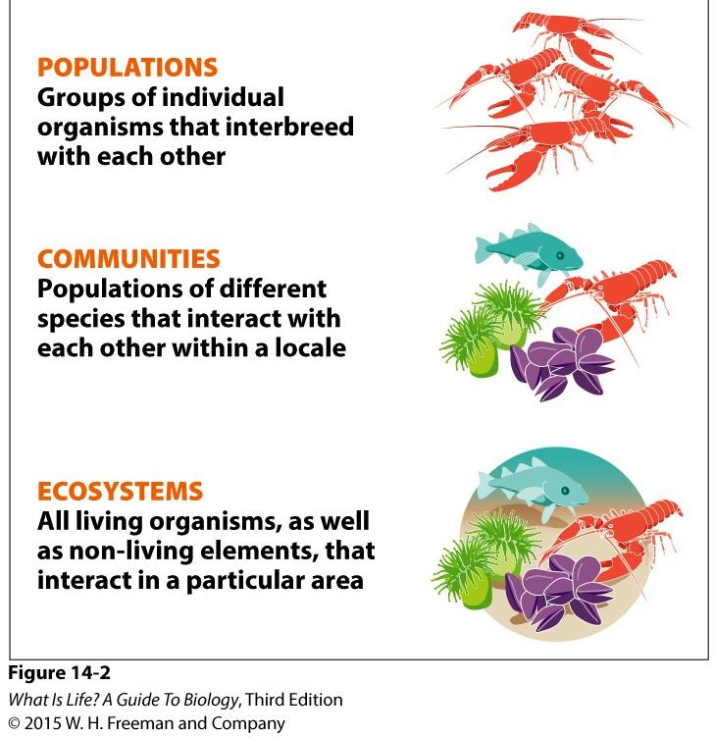
Communities
Study of communities looks at:
Food webs → How energy flows through a community
Biotic interactions → Different ways that populations of organisms interact
Succession → How disturbed communities change over time

Slide 3
Biotic interactions → Different ways that populations of organisms interact
Classified based on degree to which each species in an interaction benefits
POSITIVE/NEUTRAL
(NON-NEGATIVE)
NEGATIVE
Predation
Competition
Parasitism
Commensalism Mutualism

Slide 4
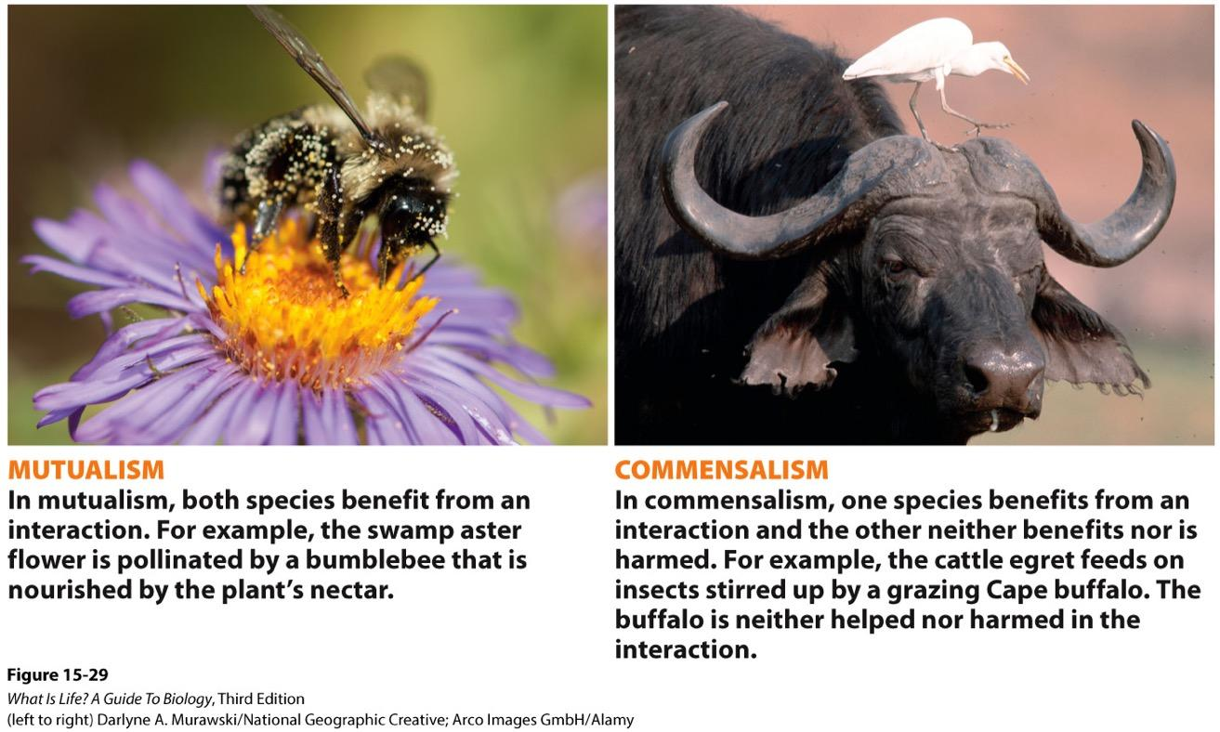
Non-negative Interactions
one species relies closely on another species that is not harmed by
the interaction
Two species work closely together for the benefit of both species
Notes:
two species work closely together for the benefit of both species

Slide 5
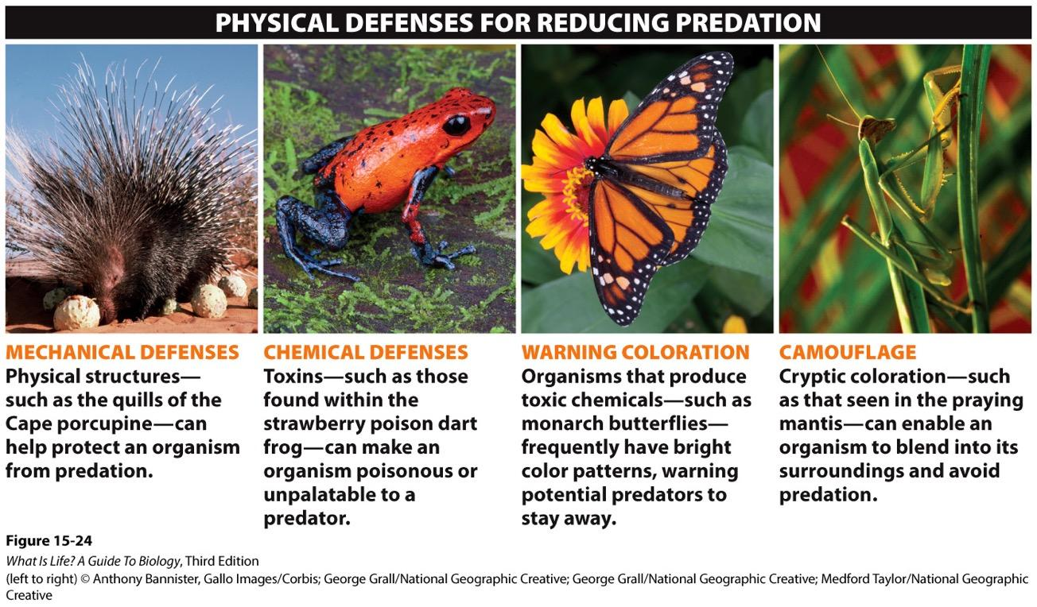
Negative Interactions: Predation
Notes:
Although the examples illustrate animal defenses, plants can use these defenses as well

Slide 6
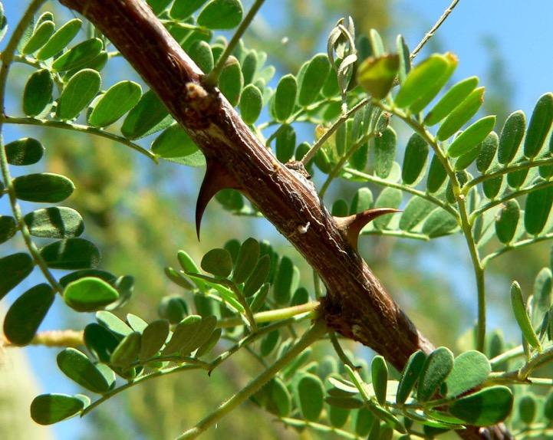
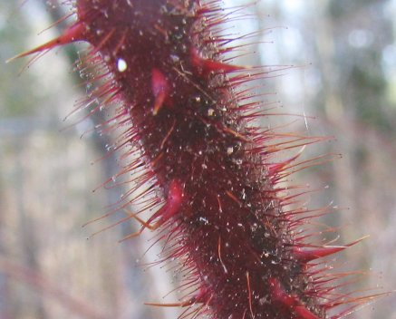
Negative Interactions: Plant Defenses
Notes:
Mechanical & chemical

Slide 7
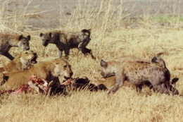
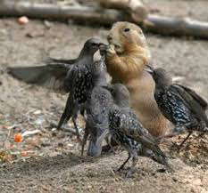
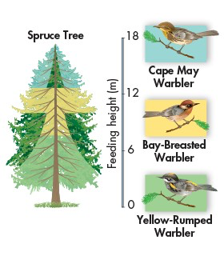
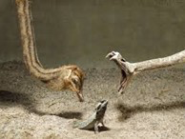
NEGATIVE INTERACTIONS: Competition

Slide 8
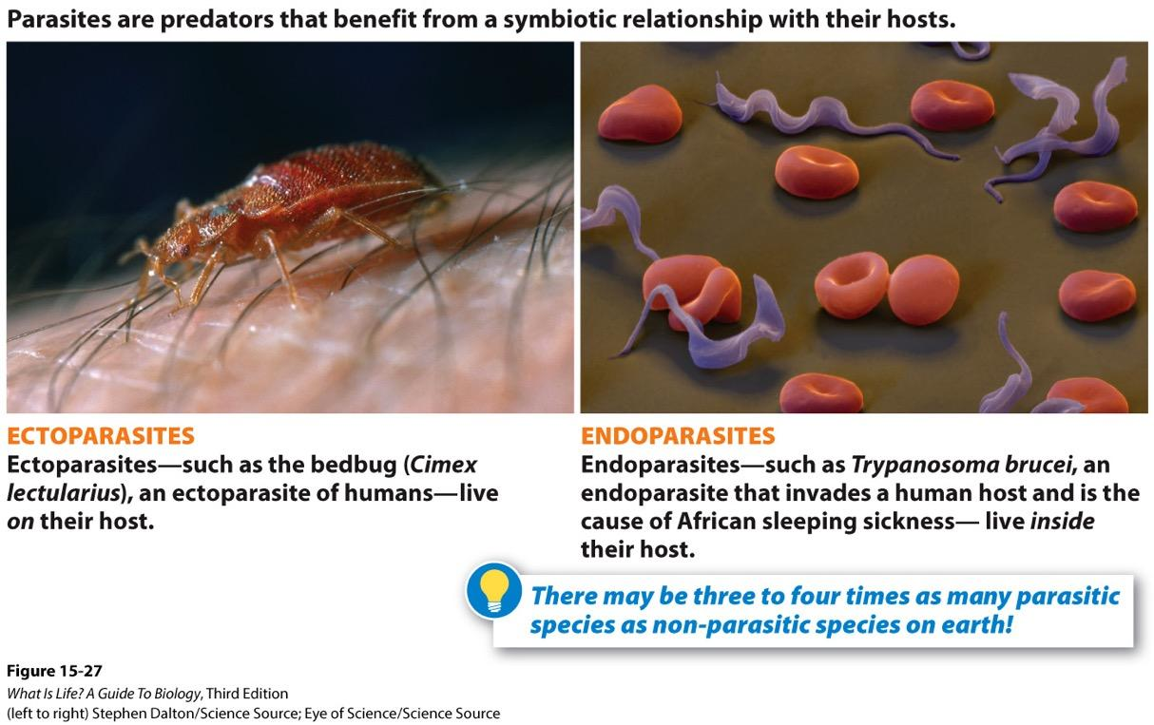
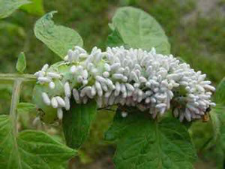
Negative Interactions: Parasitism
Wasp eggs on a caterpillar

Slide 9
Symbiosis
Symbiosis → “Living together”: organisms who depend on specific interactions with other organisms
Parasitism → positive for parasite, negative for host
Commensalism → positive for one organism, neutral for the other
Mutualism → positive for both organisms

Slide 10
Ecological succession is the process of change in the species structure of an ecological community over time.
The series of events by which life/community is reestablished after disturbance.

Slide 11
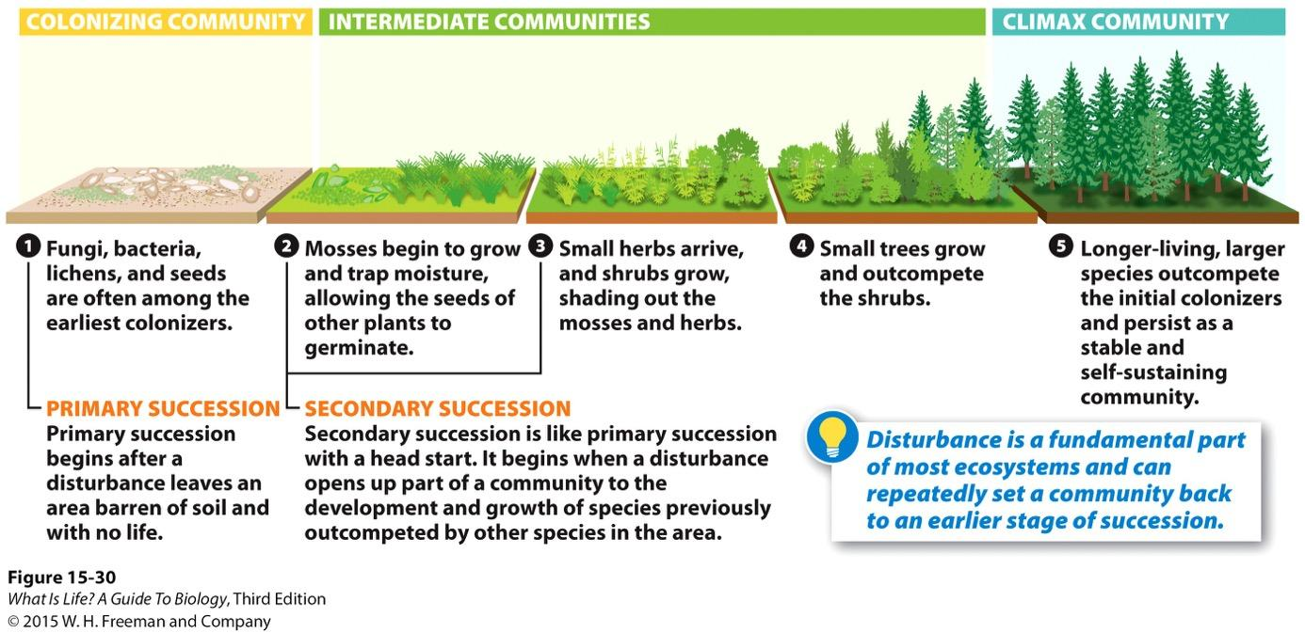
Succession
Primary Succession: Bare Rock/NO soil events
Secondary Succession: Events after soil formation

Slide 12
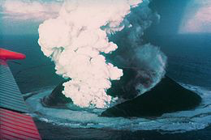
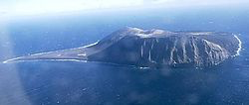
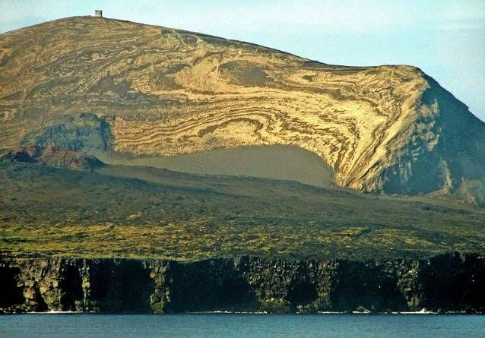
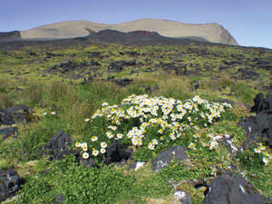
Surtsey: Volcanic island: Iceland South coast
Primary succession
1999
16 days after eruption, 1963
Pioneer/Founder organisms
Recent

Slide 13
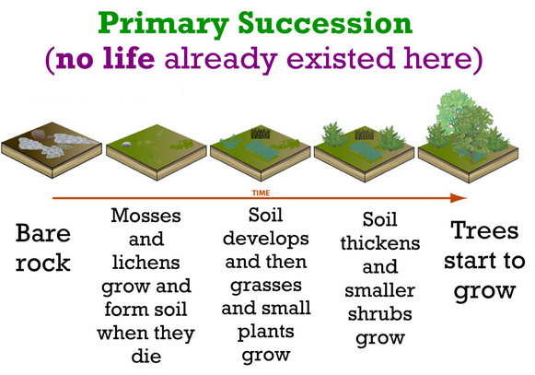

Slide 14
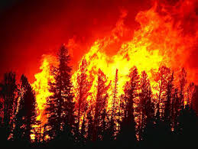
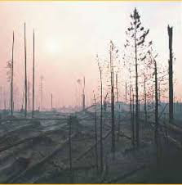
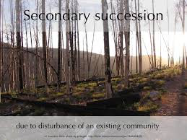
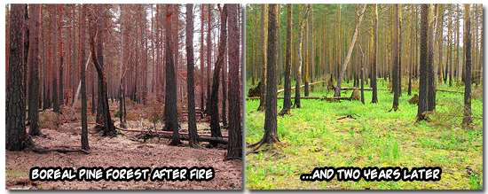
Secondary succession

Slide 15
